Slide 1

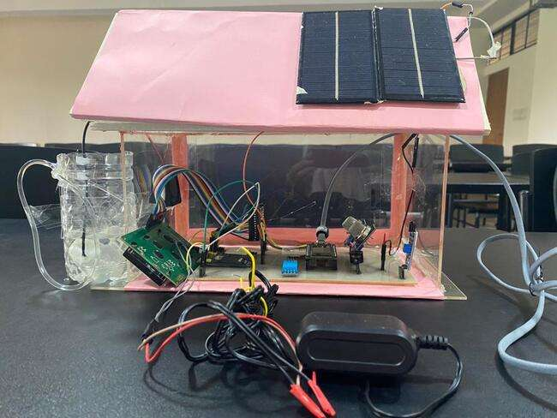





Gas Leak Detection and Explosion Prevention with Air Quality Monitoring System
C
Submitted by – Group C.5
Sanath Kumar Das
1706149
Fatin Fardaous
1706160
Sadia Afrose
1706161
Sudipta Saha
1706162
Raisa Mashtura
1706163

Slide 2
Outline
Summary
Introduction
Design
Implementation
Analysis and Evaluation
References
Presented by: 1706163

Slide 3
1. Summary / Abstract
Devised an ultimate engineering solution against gas explosion:
DETECT: Gas leak, Flame, Smoke
PREVENTIVE MEASURES: Exhaust fan, water pump, sends message, Buzzer
ADDITIONAL MEASURES: Air temperature, Humidity
SOLAR POWERED: To make use of sustainable energy
DATA UPLOADED: in Ubidot
Presented by: 1706163

Slide 4
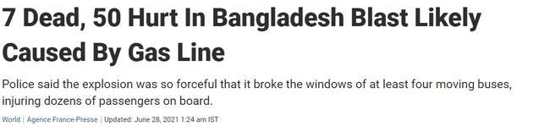
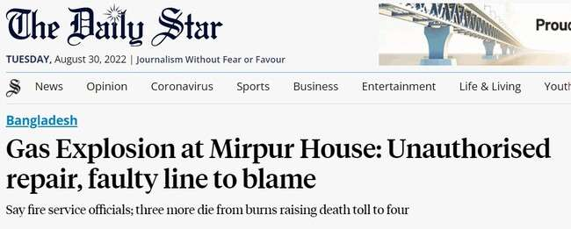
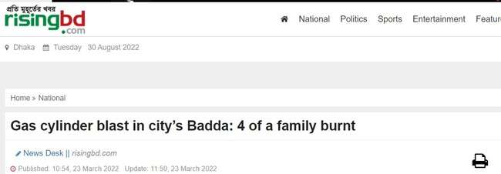
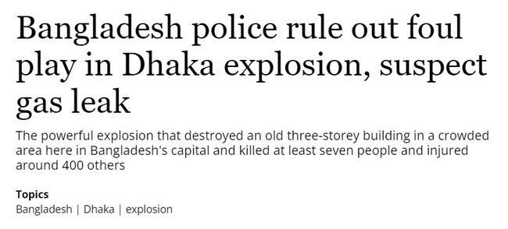
2. Introduction
Hundreds die every year due to gas leak resulting in explosion in Bangladesh. Almost all the time people are unaware. Deaths and damage could be prevented if a warning message could be sent before the danger gets out of scale.
Presented by: 1706163

Slide 5
3.1 Design: Methods
ESP32
feature-rich MCU with integrated Wi-Fi and Bluetooth connectivity for a wide-range of applications
MQ2
This is a robust Gas sensor suitable for sensing Smoke, Methane and Carbon Monoxide concentrations in the air.
MQ135
Gas sensor for monitoring air quality
Presented by: 1706162

Slide 6
3.1 Design: Methods
DHT11
Temperature and humidity sensor that comes with a dedicated NTC to measure temperature and an 8-bit microcontroller to output the values of temperature and humidity as serial data.
FLAME SENSOR
This sensor detects flame otherwise wavelength within the range of 760 nm – 1100 nm from the light source.
GSM MODULE SIM 900A
The module offers GPRS/GSM technology for communication with the uses of a mobile sim. It uses a 900 and 1800MHz frequency band and allows users to receive/send mobile calls and SMS.
Presented by: 1706162

Slide 7
3.1 Design: Methods
WATER PUMP
Just connect tube pipe to the motor outlet, submerge it in water and power it to pump water
BUZZER
Sends an alarm when flame is sensed
EXHAUST FAN
LCD Display
Displays sensor data
To drive away the gas when gas sensor detects gas concentration above a threshold ppm
Presented by: 1706162

Slide 8
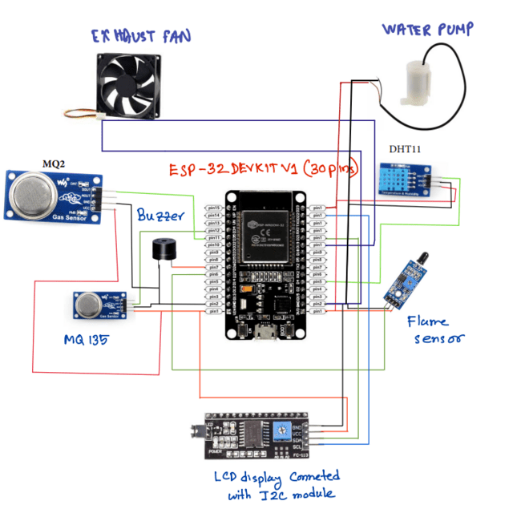
3.2 Design: Circuit Diagram
Presented by: 1706162

Slide 9
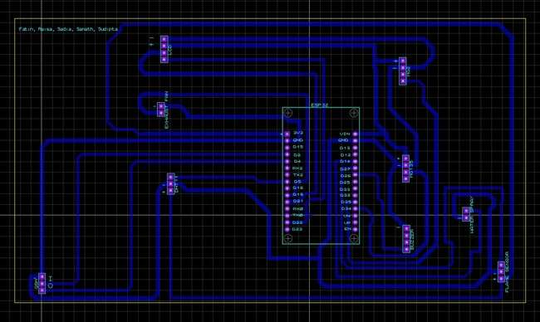
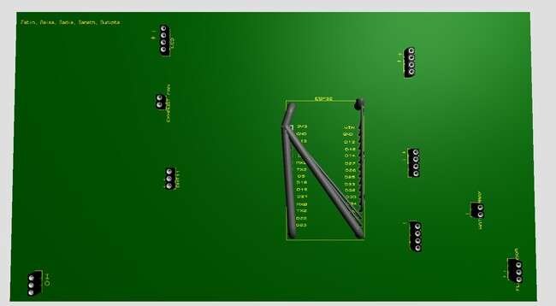
3.4 Design: PCB Layout and 3d rendering
Presented by: 1706149

Slide 10
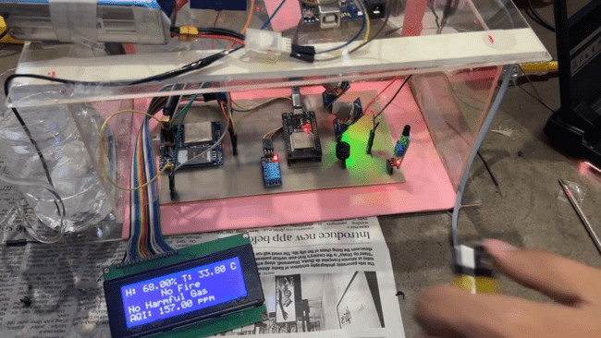
4 Implementation: Demonstration
Presented by: 1706149

Slide 11
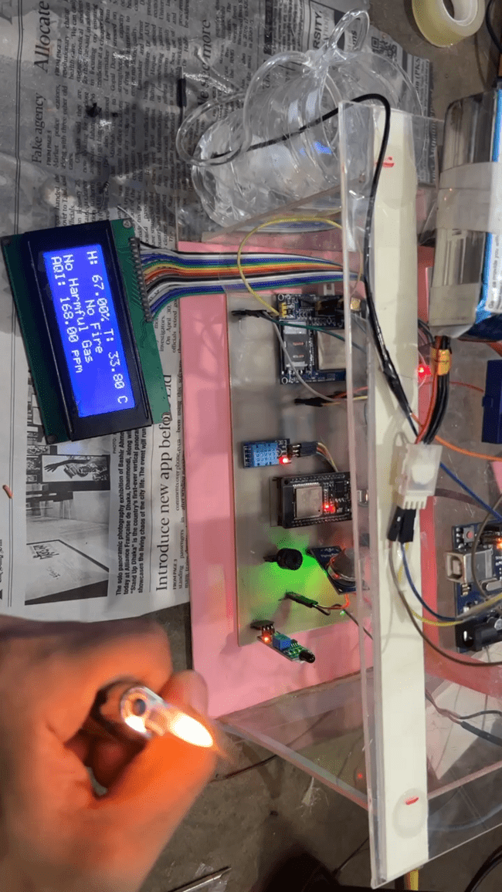
4.1 Implementation:
Presented by: 1706149

Slide 12
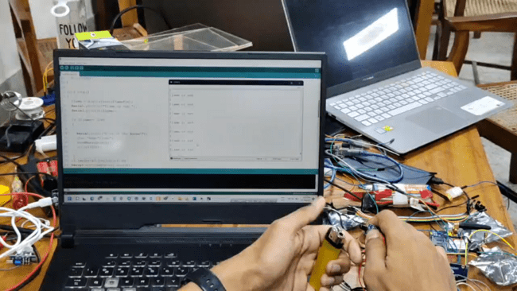
4.1 Implementation:
Presented by: 1706149

Slide 13
5. Analysis and Evaluation
5.1 Novelty:
5.2 Project Management and Cost Analysis
5.3 Practical Considerations of the Design
5.4 Assessment of the Impact of the Project
5.5 Evaluation of the Sustainability
Presented by: 1706160

Slide 14
5.1 Novelty
Solar powered: self powered system so that even if members of a household are away or there’s no mains supply, the circuit would operate
Water spray: our model accounts for preventing fire from spreading by taking spraying water on flame zone
Exhaust Fan: In case of gas leak, our model drives an exhaust fan to drive away the gas and prevent it from accumulating
Presented by: 1706160

Slide 15
5.2 Project Management and Cost Analysis
Parts name | Quantity | Cost per unit (Tk.) | Cost of part(Tk.)
ESP32 | 3 | 600 | 1800
GSM SIM900A | 3 | 900 | 2700
GSM SIM800L | 1 | 365 | 365
MQ135 | 2 | 130 | 260
MQ2 | 2 | 124 | 248
5V adapter | 1 | 200 | 200
Flame sensor | 1 | 51 | 51
PCB | 4 | 347 | 1390
LCD 20x4 | 1 | 532 | 532
Presented by: 1706160

Slide 16
5.2 Project Management and Cost Analysis
Parts name | Quantity | Cost per unit (Tk.) | Cost of part(Tk.)
I2C LCD driver | 1 | 126 | 126
Exhaust fan | 1 | 140 | 140
Water pump | 1 | 160 | 160
Frame | 1 | 570 | 570
DHT11 | 1 | 180 | 180
DHT22 | 1 | 490 | 490
Buzzer | 1 | 15 | 15
PV panel | 2 | 227 | 454
Charger circuit | 1 | 48 | 48
Presented by: 1706160

Slide 17
5.2 Project Management and Cost Analysis
Parts name | Quantity | Cost per unit (Tk.) | Cost of part(Tk.)
3.7 V Battery | 2 | 90 | 180
Soldering |  |  | 300
Transport cost |  |  | 1000
Walton USB type B | 1 | 350 | 350
Edison Type B | 1 | 110 | 110
Cost per unit |  |  | 11669
* A lot of extra cost incurred as components would get damaged very easily and had to be purchased multiple times
Presented by: 1706160

Slide 18
5.3 Practical Considerations of the Design
Makes people aware beforehand
Addresses a vital safety issue at the status quo
Uses sustainable form of energy
Helps improve air quality by raising awareness
Presented by: 1706161

Slide 19
5.4 Assessment of the Impact of the Project
Is a major safety protocol for the kitchen as nowadays our kitchens are not well ventilated.
Has the potential to saves hundreds of lives every year if this safety device is implemented at every household on a proper scale
No special legal permissions are required to implement this project as no privacy breach or anti-green action etc. took place
This does not violate any cultural norm rather makes the design of a confined kitchen safer.
Presented by: 1706161

Slide 20
5.5 Evaluation of the Sustainability
The project is supposed to have high sustainability given the sensors and module used are reliable
Calls and text messages are used to notify users- something that is very accessible to people all over the world.
From an environmental perspective, it implements solar powered panel to supply power to the system
Presented by: 1706161

Slide 21
6. Reflection on Individual and Team work
6.1 Individual Contribution of Each Member
6.2 Mode of TeamWork
6.3 Diversity Statement of Team
6.4 Log Book of Project Impelementation
Presented by: 1706161

Slide 22
6.1 Individual Contribution of Each Member
Sanath- ESP32, Sensors, Design, Assembling
Sudipta- Design, Assembling
Fatin- ESP32, Sensors
Sadia- GSM, Assembling
Raisa- PCB design, Assembling
Presented by: 1706XXX

Slide 23
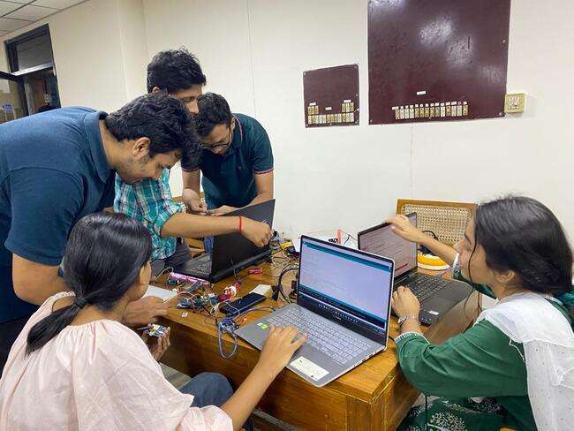
6.2 Mode of TeamWork and Diversity
Our team comprises of members of different genders, with different home districts and cultural background.
We also tried to accommodate to each other’s convenience and divided our work accordingly at the beginning. Later on, upon completion of individual tasks, we assembled the project together to resolve the final issues.
All throughout, all of us had a mindset that we will definitely accomplish our assigned tasks and more.
Presented by: 1706161

Slide 24
6.3 Logbook of Project
Date | Milestone achieved
01/07 | Project planning
03/07 | Components bought
16/07 | Sensor data taken, regulated and displayed
20/07 | GSM module made to send call
21/07 | Arduino code implemented in a wifi module
25/07 | Discard and now coded for esp32
30/07 | Online server connected, data uploaded
10/08 | GSM went wrong, tried multiple times
15/08 | PCB design
20/08 | PCB printed
21/08 | Ideas for novelty brainstormed
Presented by: 1706161

Slide 25
6.3 Logbook of Project
Date | Milestone achieved
23/08 | More components bought
27/08 | PCB error so design again
28/08 | PCB printed
29/08 | Soldering done
 | Glass frame designed
30/08 | Assembled
 | Data verification and testing of sensors
 | Final Demonstration
Presented by: 1706161

Slide 26
7. References
https://www.engineersgarage.com/pcb-layout-design-with-proteus/#:~:text=Proteus%20has%20the%20integrated%20ARES,with%20list%20of%20component%20packages.
https://thingspeak.com/
https://www.youtube.com/watch?v=3tXRNusJhgs
https://www.youtube.com/watch?v=nUcrrCJd1sY
https://www.snapeda.com/home/
Presented by: 1706XXX

